Slide 1
Nov 1 Tagup

Slide 2
Analysis of the Aug. 4 13:30-14:00 Event
Environmental Context
Spacecraft Location
Observed Magnetic field
Magnetic field line and footprints
Pitch Angle Distributions
Error Sources and Gyrotropy

Slide 3
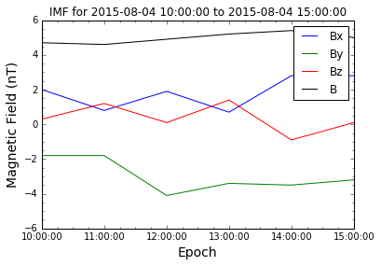
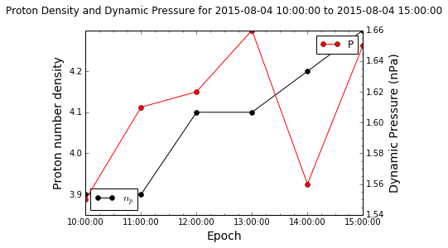
Environmental Context (1/2)
IMF is steady with a weak Bz, and a steady By ~-3 nT
The solar wind conditions so a low end pressure with little variation in speed (430-450 km/s)

Slide 4
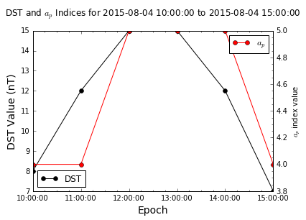
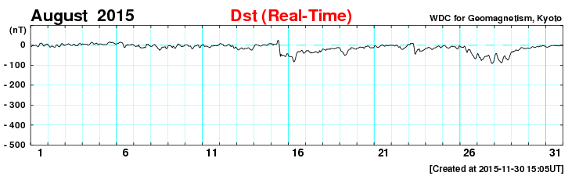
Environmental Context (2/2)
a_{p} index very low (equivalent K_{p} of 1 to 1+)
The DST values are also very low (for comparison the month of August is shown as well)

Slide 5
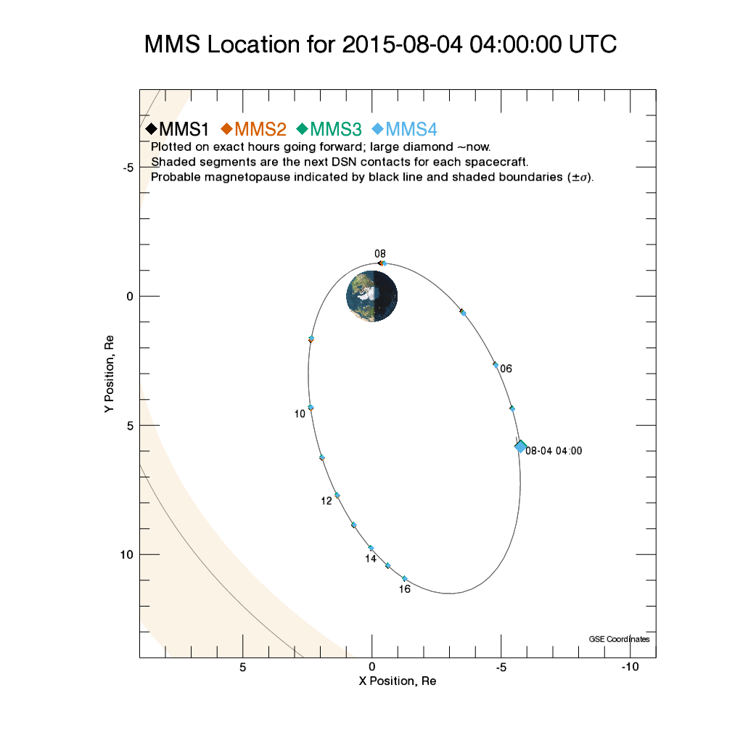
Spacecraft Location

Slide 6
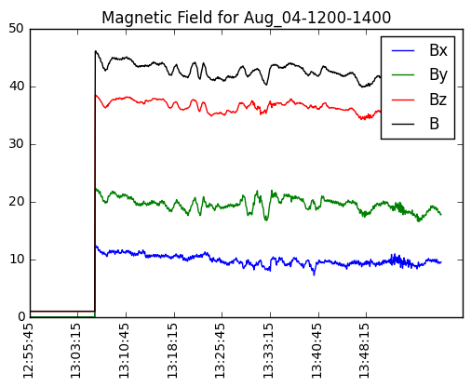
Magnetic Field

Slide 7
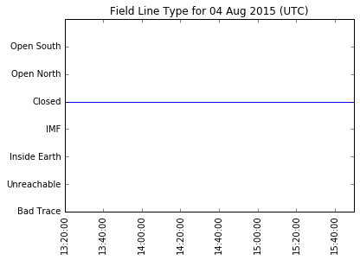
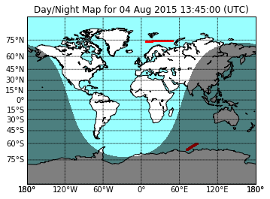
Magnetic Footprints
The field line lines seen by the spacecraft are closed
Northern footprint in sunlight, southern clearly not
Magnetic local times are:
7.8-9.4 North
0.5-0.8 South
Magnetic latitude are:
85-87.5 degrees North
-47 to -51 degrees South

Slide 8
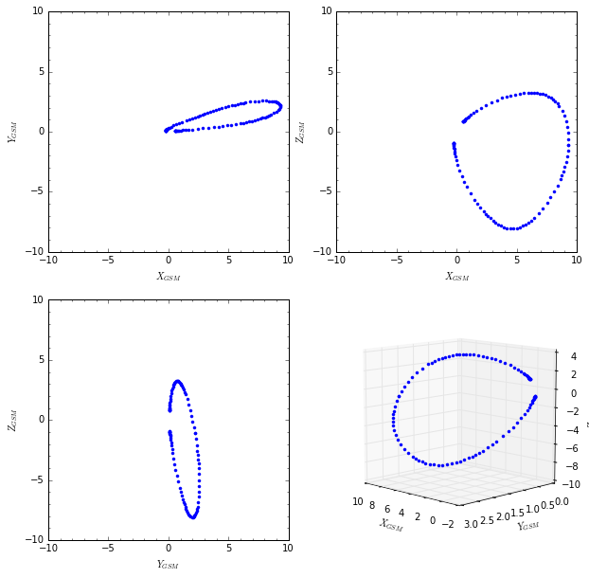
Field Line Trace

Slide 9
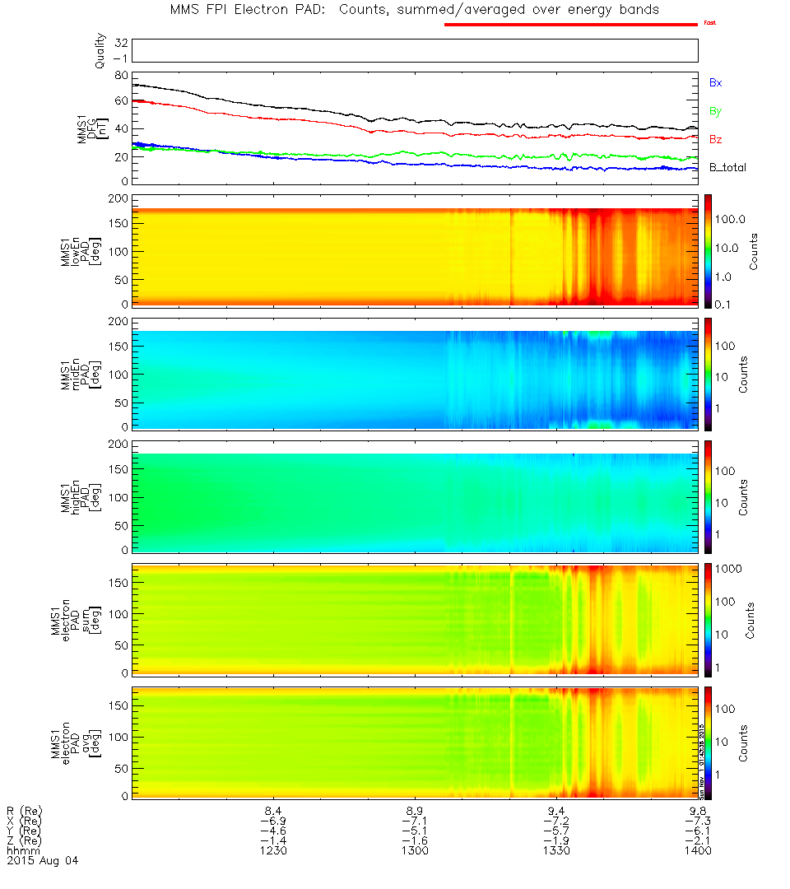
Quicklook Context

Slide 10
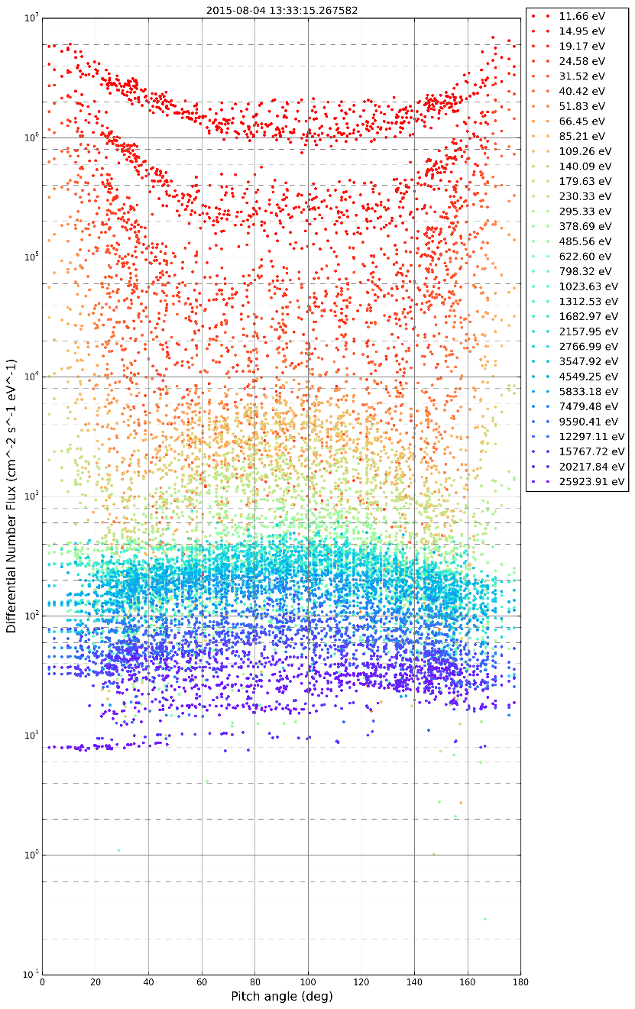
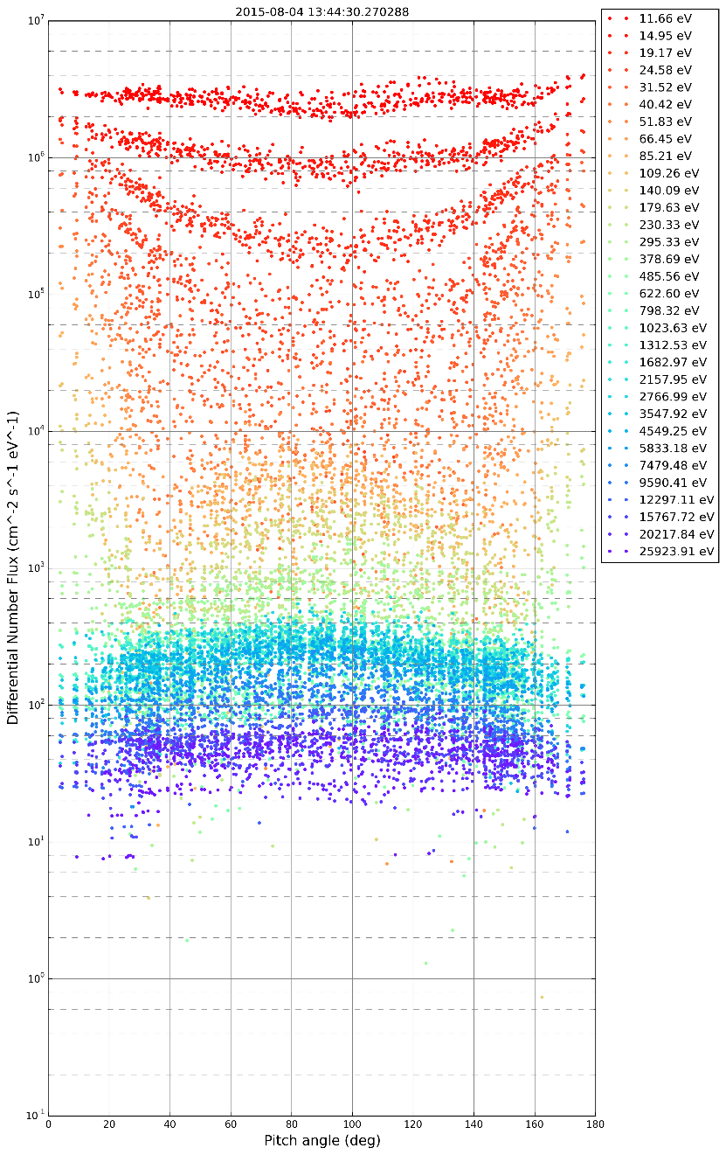
Raw PADs for Selected Times
Aug. 04 13:33
Aug. 04 13:44

Slide 11
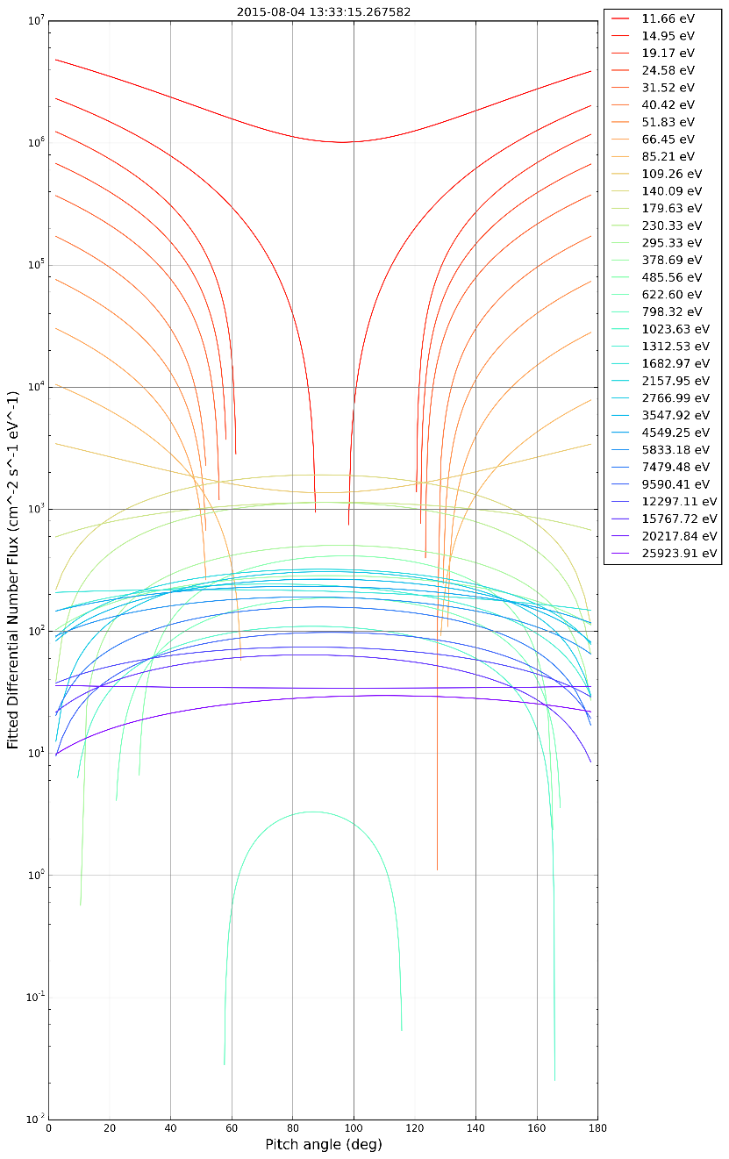
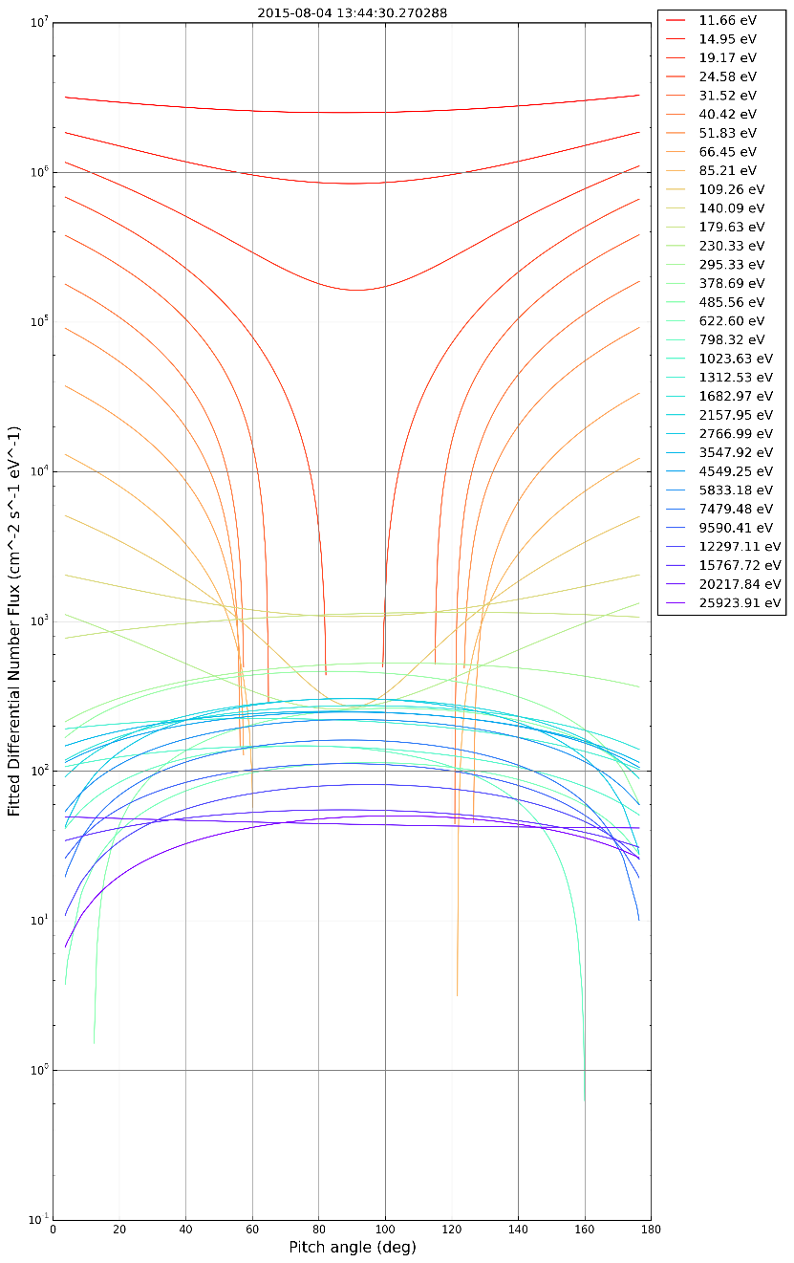
Smooth PADs for Selected Times
Aug. 04 13:33
Aug. 04 13:44

Slide 12
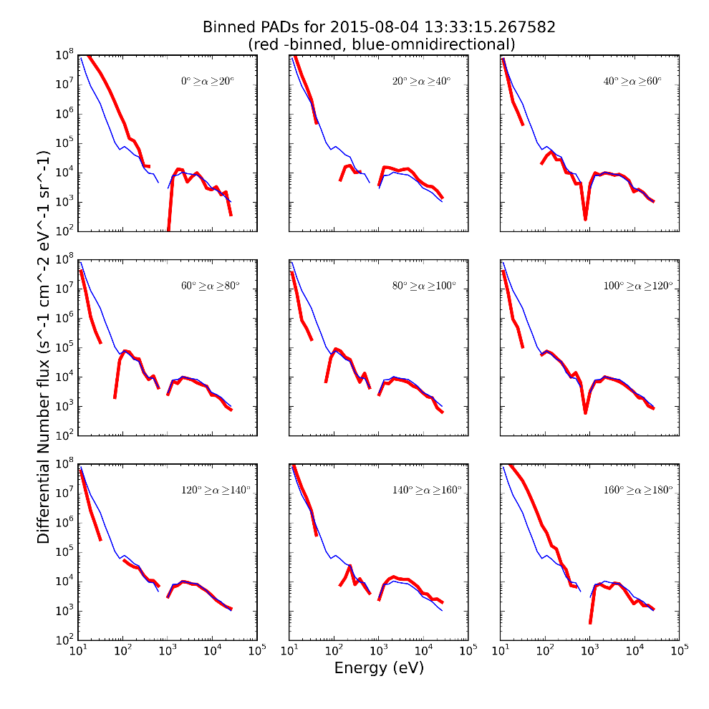
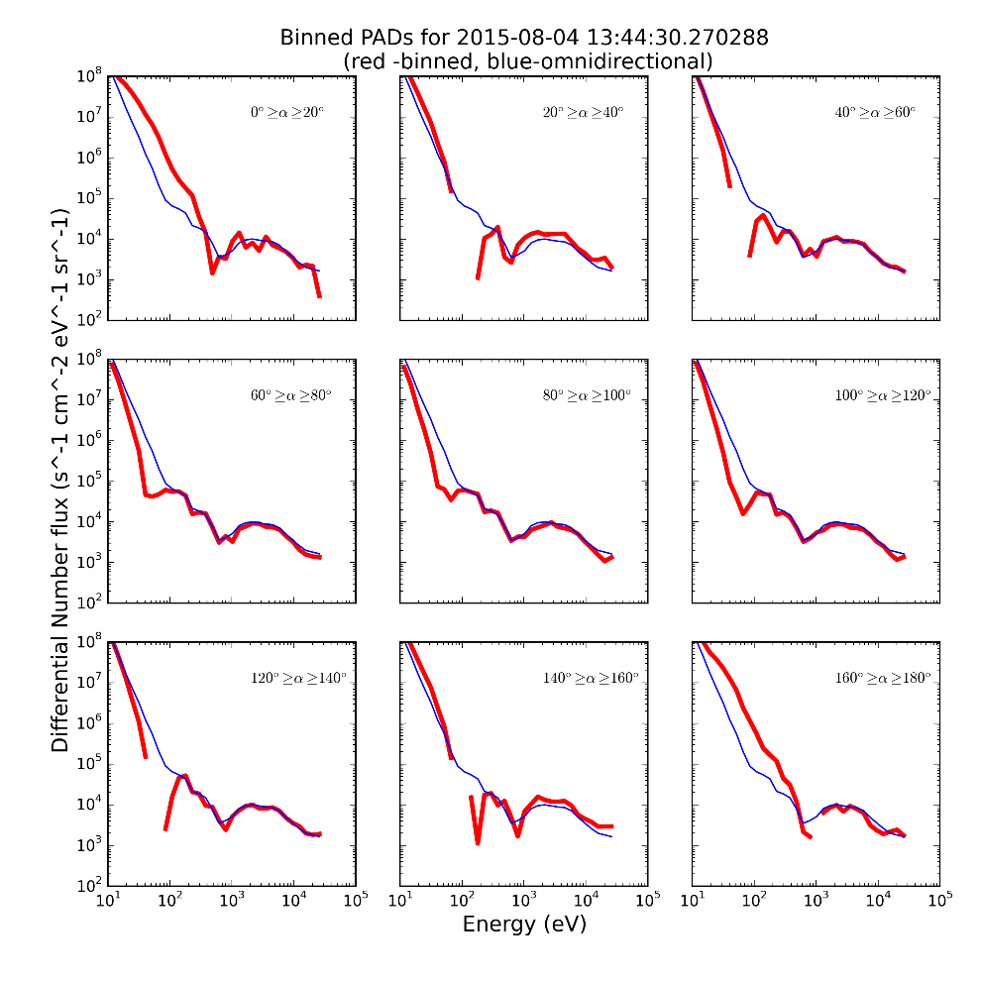
PA-limited spectra for Selected Times
Aug. 04 13:33
Aug. 04 13:44

Slide 13
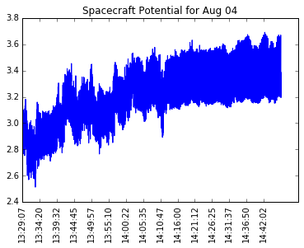
Spacecraft Potential
ASPOC control of spacecraft potential keeps it below the lowest FPI bin
Spacecraft potential very low < 4 V
Spacecraft generated photoelectrons can be ignored

Slide 14
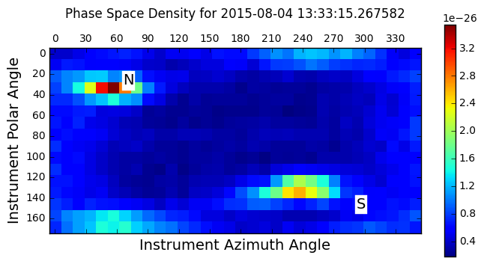
Gyrotropy
Pressure tensor has eigenvalues
λ_{i} = (0.00615, 0.00653, 0.00672) showing gyrotropic plasma
Low energy counts, when corrected for internally-generated photoelectrons, also show gyrotropy

